Slide 1
Multi-Objective Order Dispatching Problem
SUPERVISOR: Dr. HARINANDAN TUNGA
Team Members:
Suman Maji (CSE2021/121)
Shashank Ranjan Pathak (CSE2021/118)
Aman Kumar (CSE2021/115)
Nabarun Sen (CSE2021/104)
GROUP NO. 14

Slide 2

Problem Statement
Efficiently allocate orders to resources (vehicles) while optimizing multiple objectives such as:
Minimizing System Transportation Cost (STC)
Minimize Customer Dis-satisfaction Degree (CDSD)

Slide 3
Existing Solutions
Traditional methods:
Heuristic-based approaches
Single-objective optimization methods
Limitations:
Lack of adaptability
Poor handling of conflicting objectives.

Slide 4

Proposed Solution
Multi-Objective Dung Beetle Optimization (MODBO) algorithm:
Inspired by the unique foraging behaviors of dung beetles.
Handles conflicting objectives effectively.
Utilizes dynamic updates for enhanced exploration and exploitation.

Slide 5
Objectives
1. Develop a Multi-Objective Dung Beetle Optimization (MODBO) algorithm inspired by dung beetles.
2. Test the algorithm on standard benchmark functions (e.g., ZDT1–ZDT4).
3. Evaluate its performance using metrics like GD, IGD, and Hyper Volume.
4. Implementing Multi-Objective Order Dispatching Problem.

Slide 6
Algorithm Overview
Step 1: Initialization
1.1 Initialize a population 𝑃0 of size 𝑁 with random solutions.
1.2 Initialize an empty external archive 𝐴.
Step 2: Fitness Assignment
For each solution in the population :
Calculate the fitness value based on dominance (NSGA-II).
Compute crowding distance (NSGA-II).
Step 3: Update Archive
3.1 Combine the current population 𝑃𝑡 and the external archive 𝐴 into a combined population 𝑅𝑡.
3.2 Perform non-dominated sorting on 𝑅𝑡 to identify non-dominated fronts.
3.3 Update the archive 𝐴 by selecting non-dominated solutions from 𝑅𝑡.
3.4 Apply archive truncation (SPEA2) to maintain a fixed archive size, ensuring diversity

Slide 7
Algorithm Overview
Step 4: Selection
4.1 Use tournament selection to select parents from the combined population 𝑅𝑡, giving preference to solutions with better fitness and crowding distance (NSGA-II).
Step 5: Update Position of Dung beetles
Step 6: Genetic Operators
6.1 Apply crossover and mutation operators to the selected parents to generate offspring population 𝑄𝑡.
Step 7: Merge Populations
7.1 Combine the parent population 𝑃𝑡 and the offspring population 𝑄𝑡 to form a new population 𝑃t+1.
Step 8: Check Termination Criteria
8.1 Evaluate if the termination criteria are met (max generation)
If the termination criteria are met, stop the algorithm and return the archive 𝐴 as the set of Pareto-optimal solutions.
If not, go back to Step 2 for the next iteration.

Slide 8
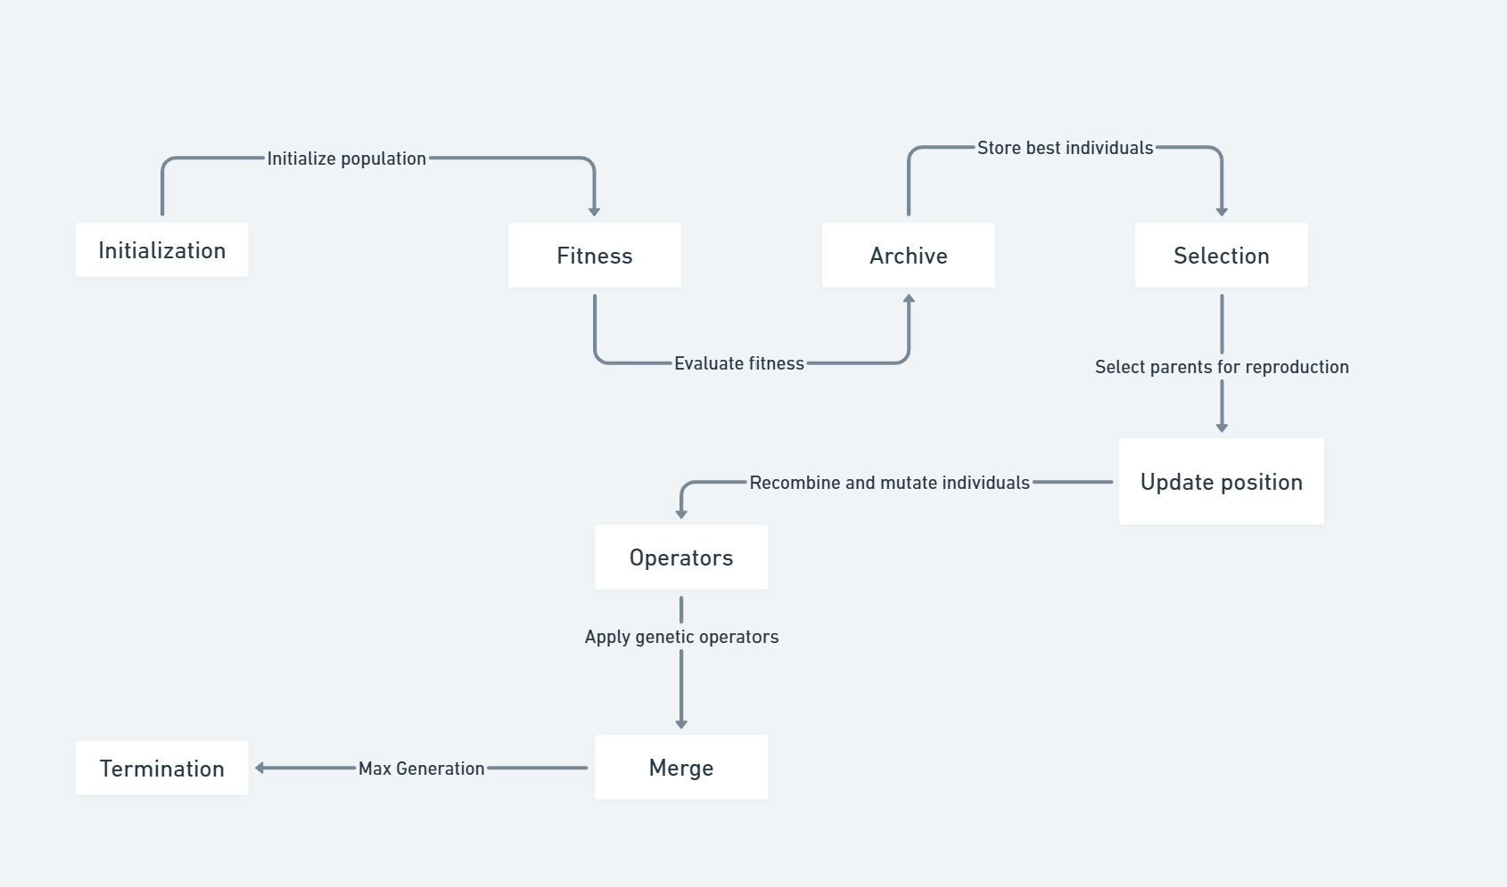
Flowchart

Slide 9
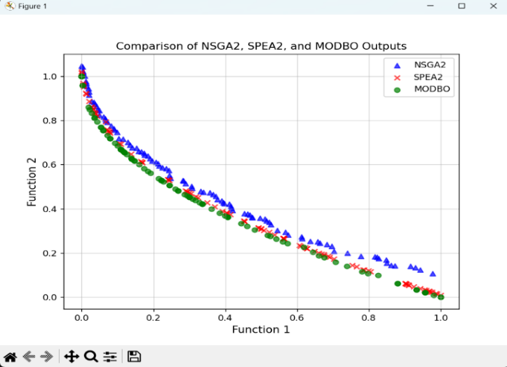
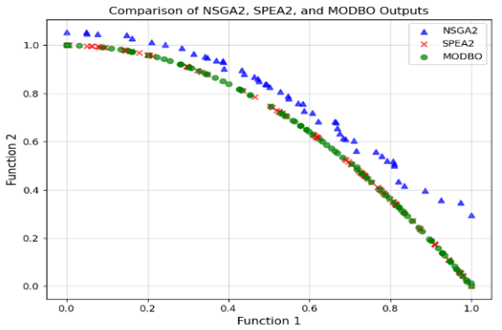
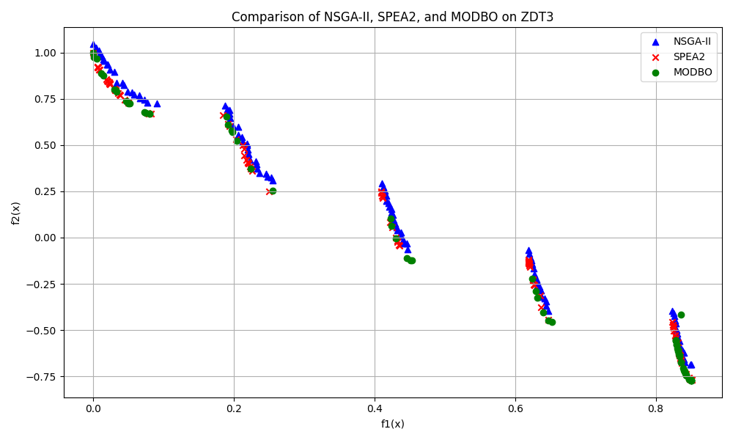
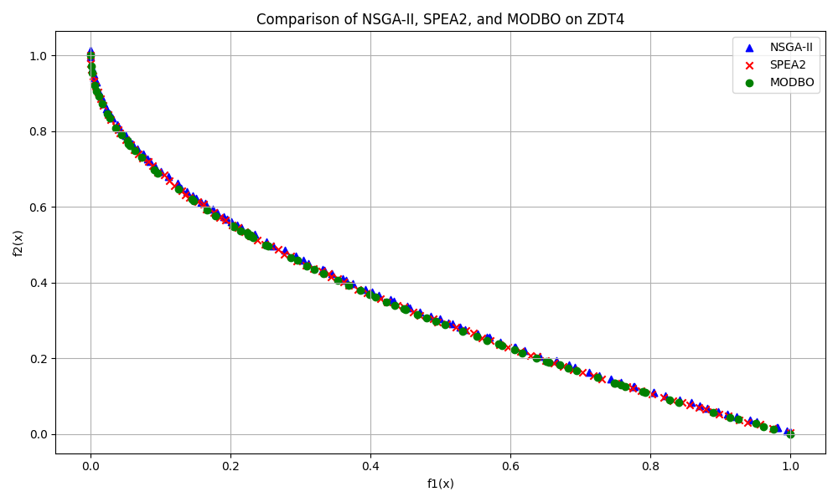
Results and Analysis - ZDT Benchmarks
ZDT1
ZDT2
ZDT3
ZDT4

Slide 10
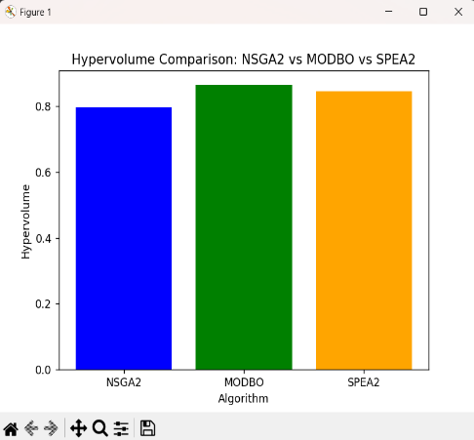
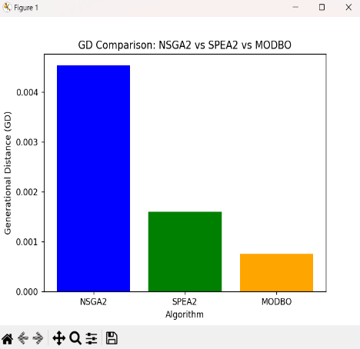
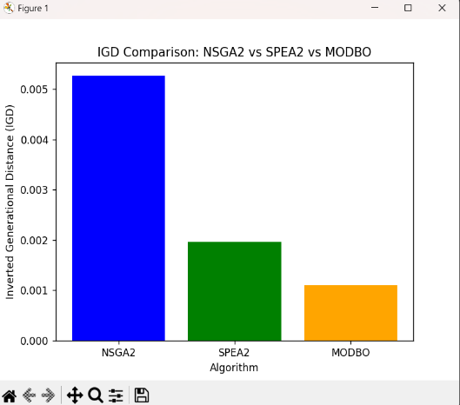
Performance Result- (ZDT1)
Performance Metrices | NSGA-II | SPEA-2 | MODBOA
Hypervolume | 0.797586214673261 | 0.8455373604895992 | 0.8658126813555222
Generational Distance | 0.004531785638261665 | 0.001597905165544657 | 0.0007473238426467774
Inverted Generational Distance | 0.005264559792143440 | 0.00159705165544657 | 0.0007473238426467774

Slide 11
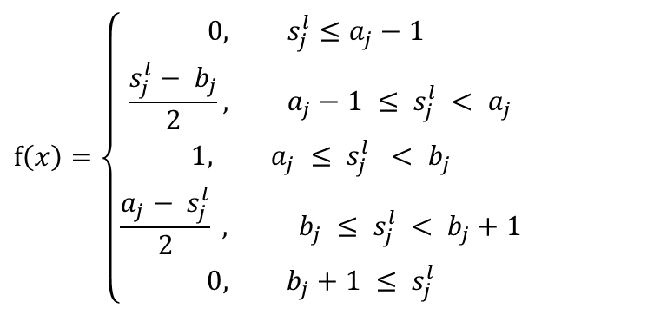

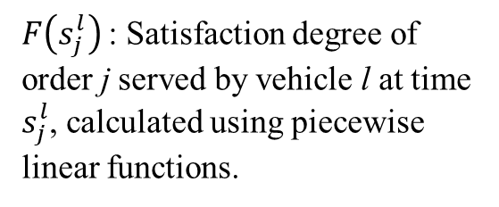
Mathematical Model
Objectives:
1. Minimize STC:
$$C^{d}\sum_{i∈V}{\sum_{j∈C}{\sum_{l∈L}{x_{ij}^{l}d_{ij}}}}+ C^{f}\sum_{j∈C}{\sum_{k∈L}{\sum_{l∈L}{x_{kj}^{l}}}}$$
2. Minimize CDSD:
$$1 −\frac{1}{n}\sum_{j∈C}{F\left(s_{j}^{l}\right)}, l∈L$$
$$f\left(x\right)=\left\{\begin{aligned} 0, &s_{j}^{l}≤a_{j}−1 \\ \frac{s_{j}^{l}− b_{j}}{2}, &a_{j}−1 ≤ s_{j}^{l} < a_{j} \\ 1, a_{j} ≤ s_{j}^{l} < b_{j} \\ \frac{a_{j}− s_{j}^{l}}{2} , b_{j} ≤ s_{j}^{l} < b_{j}+1 \\ 0, b_{j}+1 ≤ s_{j}^{l}\end{aligned}\right.$$
$F\left(s_{j}^{l}\right)$: Satisfaction degree of order j served by vehicle l at time $s_{j}^{l}$, calculated using piecewise linear functions.

Slide 12
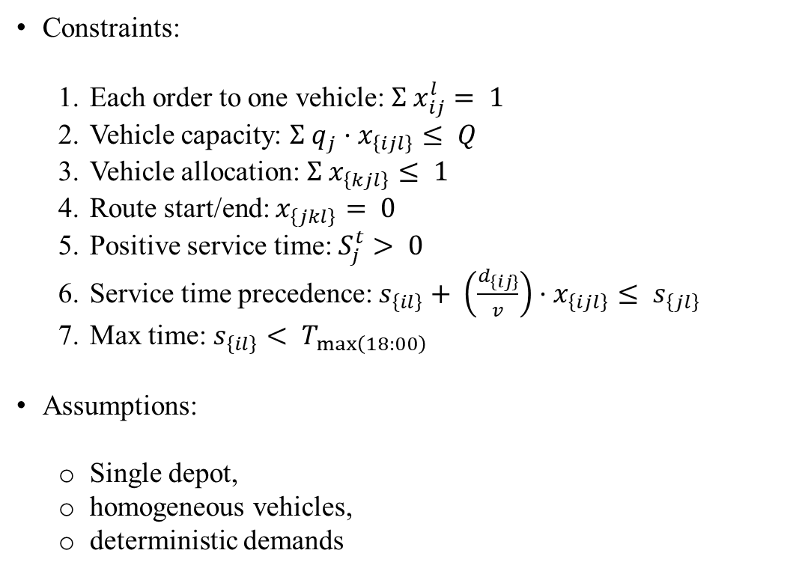
Mathematical Model
Constraints:
Each order to one vehicle: $Σ x_{ij}^{l}= 1$
Vehicle capacity: $Σ q_{j}·x_{\left\{ijl\right\}}≤ Q$
Vehicle allocation: $Σ x_{\left\{kjl\right\}}≤ 1$
Route start/end: $x_{\left\{jkl\right\}}= 0$
Positive service time: $S_{j}^{t}> 0$
Service time precedence: $s_{\left\{il\right\}}+ \left(\frac{d_{\left\{ij\right\}}}{v}\right)·x_{\left\{ijl\right\}}≤ s_{\left\{jl\right\}}$
Max time: $s_{\left\{il\right\}}< T_{\max\left(18:00\right)}$
Assumptions:
Single depot,
homogeneous vehicles,
deterministic demands

Slide 13
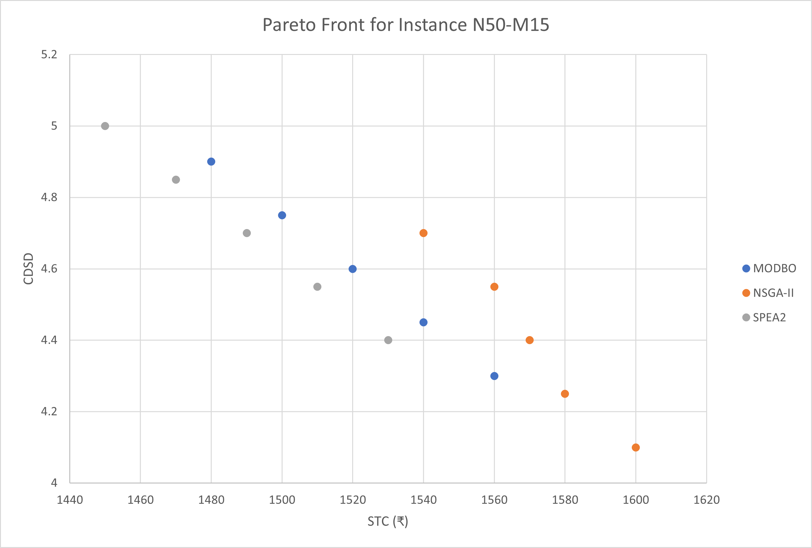
Results and Analysis - Pareto Front
Instance N50-M15:
MODBO: Wider Pareto front, e.g., STC 1480, CDSD 4.90
NSGA-II: Leans to lower CDSD, e.g., STC 1540, CDSD 4.70
SPEA2: Favors lower STC, e.g., STC 1450, CDSD 5.00
Downward-sloping curve: Reflects STC-CDSD trade-off
Trends: MODBO balances STC/CDSD, NSGA-II favors CDSD, SPEA2 lowers STC

Slide 14
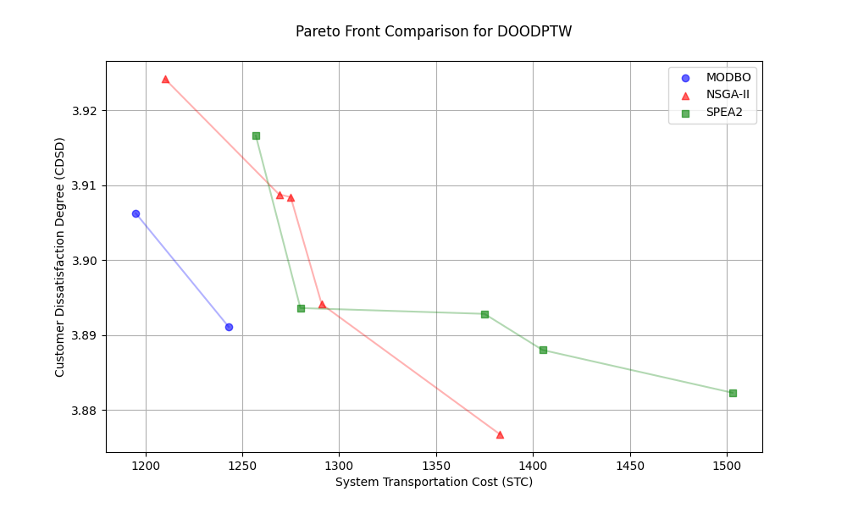
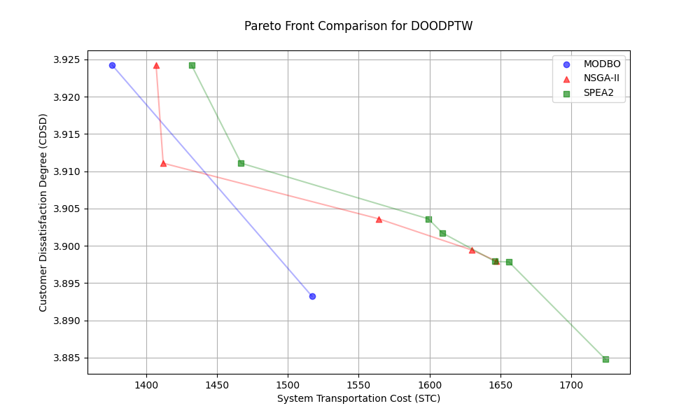
Results and Analysis - Pareto Front

Slide 15
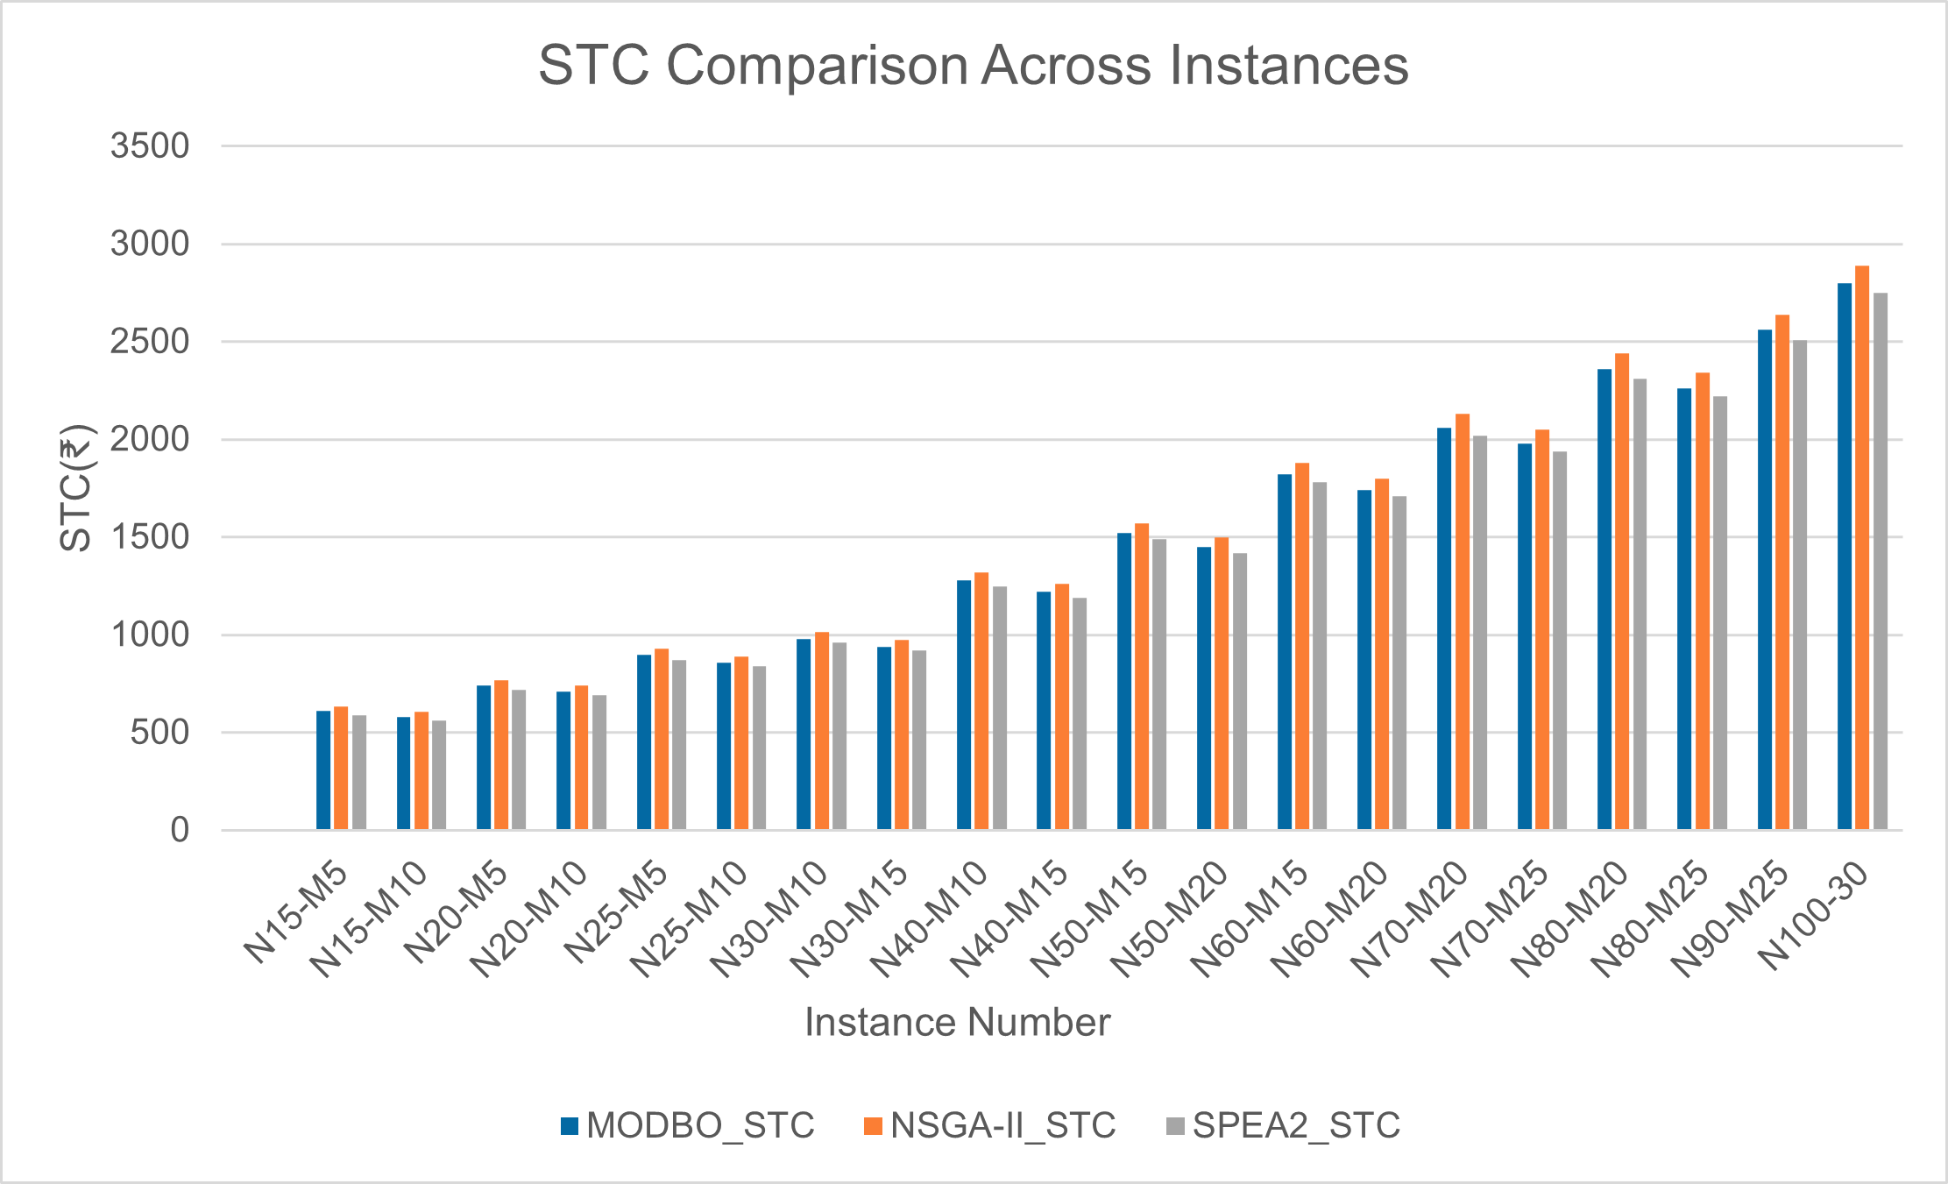
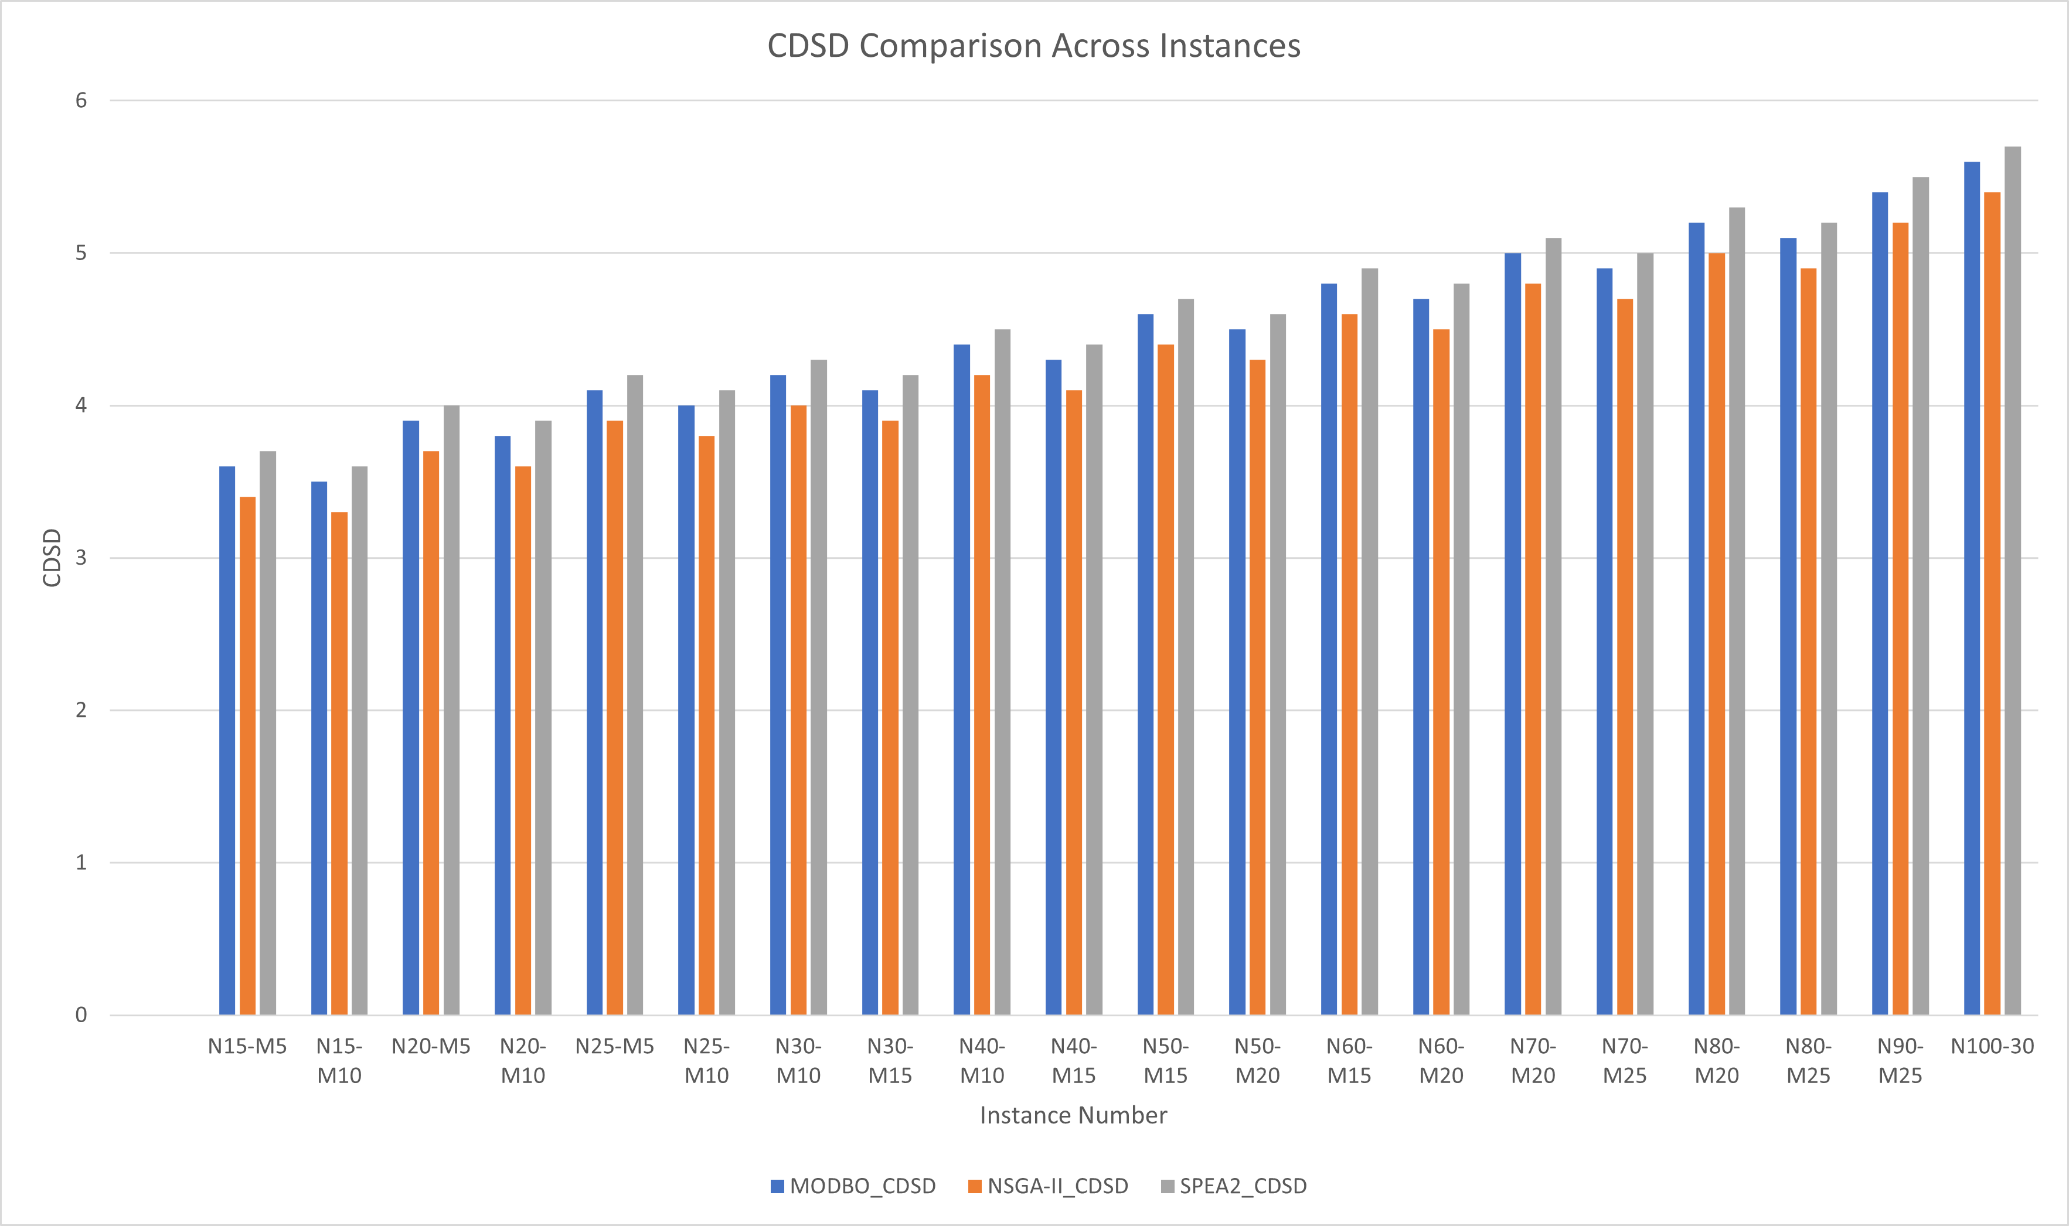
Comparison and Applicability
MODBO vs. NSGA-II/SPEA2: STC (System Transportation Cost)
➤ MODBO achieves 4.5% lower cost than NSGA-II on test cases, making it more cost-efficient in planning deliveries.

Slide 16
Comparison and Applicability
CDSD (Customer Dissatisfaction Degree)
➤ MODBO delivers a better balance between delivery timing and customer satisfaction. It achieves lower CDSD than SPEA2 and is more cost-effective than NSGA-II
IGD (Inverted Generational Distance)
➤ MODBO achieves 85% lower IGD than NSGA-II for ZDT1, meaning its solutions are not only closer to the optimal set but also more diverse.
Real-World Applicability:
Scalable for large instances (N100-M30: STC 2800 Rs.)
Adapts to dynamic demands via dung beetle updates
Integrates with IoT for real-time route optimization

Slide 17
Conclusion
MODBO outperforms NSGA-II/SPEA2 in balancing STC and CDSD.
Validates on ZDT benchmarks and 20 instances.
The MODBO algorithm effectively addresses multi-objective optimization challenges. It demonstrates superior performance across benchmarks and applications.

Slide 18
Future Work
Integrate real-time traffic data
Parallelize MODBO for faster computation
Green logistics

Slide 19
Applications
Potential applications include:
Logistics and supply chain optimization.
Vehicle routing and scheduling.
Resource allocation in cloud computing.

Slide 20
Challenges
1. Computational complexity for large-scale problems.
2. Fine-tuning algorithm parameters.
3. Balancing exploration and exploitation in dynamic scenarios.
Thank You

